Slide 1

CONCEPTIAL DESIGN PRESENTATION

Slide 2

Mustafa Ercan OKATAN

Slide 3
Time Management
Financial Management
Deliverables

Slide 4
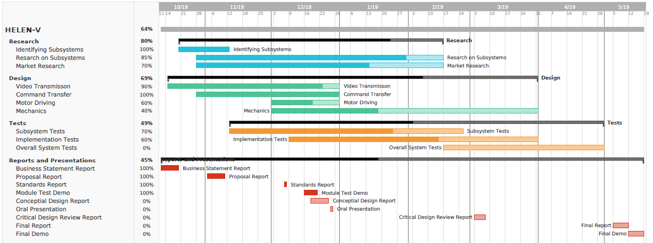
Time Management

Slide 5
Financial Management
Product | Pieces | Unit Price($) | Total Price($)
nrf24l01+ | 2 | 1.78 | 3.56
TS5828s | 1 | 7.70 | 7.70
Camera | 1 | 6.27 | 6.27
Video Receiver | 1 | 21.99 | 21.99
Arduino uno | 2 | 3.21 | 6.42
Joystick | 1 | 2.84 | 2.84
15dBi antenna | 2 | 2.24 | 4.48
12V Battery | 1 | 9.55 | 9.55
Power-bank | 2 | 4.75 | 9.50
DC motor | 2 | 8 | 16
L298n | 1 | 1.43 | 1.43
Omni Wheel | 3 | 8.55 | 25.65
Connection equipment and body | 1 | 20 | 20
Estimated cost of the shooting mechanism |  |  | 20
Unexpected costs |  |  | 20
TOTAL | 17 pcs |  | 175.5

Slide 6
Deliverables
1 X Robot: HELEN-V
1X User manual
a certificate of warranty
2 X Battery charger
2 X Ball
6 X wall of the playfield
2 X Substitute battery

Slide 7
Conclusion

Slide 8
Thank you for listening

Slide 9
REFERENCES
Hamby, C. (2013, November 26). Top Benefits And Top Disadvantages To Using A 5.8 GHz Frequency? Retrieved from https://www.avalan.com/blog/bid/354696/Top-Benefits-And-Top-Disadvantages-To-Using-A-5-8-GHz-Frequency
Perlman, A. (2016, August 20). Everything You Need to Know About FPV Flying. Retrieved from https://uavcoach.com/everything-need-know-fpv-flying/
User’s Basic Guide to Radio Control Systems. (n.d.). Retrieved from http://www.rcmodelswiz.co.uk/rc-guides/electric-rc-models-guide/users-basic-guide-to-radio-control-systems/
Wheel Control Theory. (n.d.). Retrieved from http://www.robotplatform.com/knowledge/Classification_of_Robots/wheel_control_theory.html

